Slide 1
Outline
Introduction
Cluster Distance Measures
Agglomerative Algorithm
Example and Demo
Relevant Issues
Summary
COMP24111 Machine Learning

Slide 2
Introduction
Hierarchical Clustering Approach
  A typical clustering analysis approach via partitioning data set sequentially
  Construct nested partitions layer by layer via grouping objects into a tree of clusters (without the need to know the number of clusters in advance)
  Use (generalised) distance matrix as clustering criteria
Agglomerative vs. Divisive
  Two sequential clustering strategies for constructing a tree of clusters
  Agglomerative: a bottom-up strategy
    Initially each data object is in its own (atomic) cluster
    Then merge these atomic clusters into larger and larger clusters
  Divisive: a top-down strategy
    Initially all objects are in one single cluster
    Then the cluster is subdivided into smaller and smaller clusters
COMP24111 Machine Learning

Slide 3
Introduction
Illustrative Example
  Agglomerative and divisive clustering on the data set {a, b, c, d ,e }
Step 0
Step 1
Step 2
Step 3
Step 4
Agglomerative
a
a b
b
Cluster distance
Termination condition
a b c d e
c
c d e
d
d e
e
Divisive
Step 4
Step 3
Step 2
Step 1
Step 0
COMP24111 Machine Learning

Slide 4
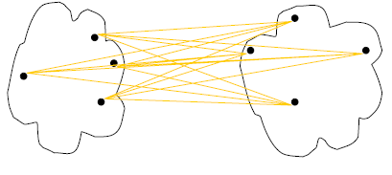
Cluster Distance Measures
Single link: smallest distance between an element in one cluster and an element in the other, i.e., d(C_{i}, C_{j}) = min{d(x_{ip}, x_{jq})}
Complete link: largest distance between an element in one cluster and an element in the other, i.e., d(C_{i}, C_{j}) = max{d(x_{ip}, x_{jq})}
Average: avg distance between elements in one cluster and elements in the other, i.e.,
d(C_{i}, C_{j}) = avg{d(x_{ip}, x_{jq})}
single link
(min)
complete link
(max)
average
d(C, C)=0
COMP24111 Machine Learning
Notes:
Define D(C, C)=0, the distance between two exactly same clusters is ZERO!

Slide 5
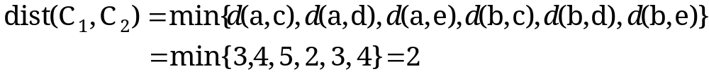
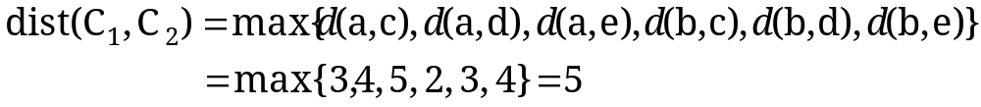
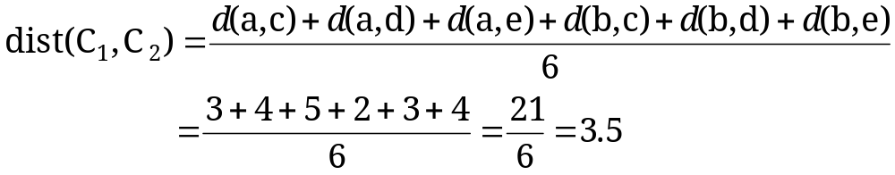
Cluster Distance Measures
  Example: Given a data set of five objects characterised by a single continuous feature, assume that there are two clusters: C1: {a, b} and C2: {c, d, e}.
  1. Calculate the distance matrix. 2. Calculate three cluster distances between C1 and C2.
 | a | b | c | d | e
Feature | 1 | 2 | 4 | 5 | 6
Single link
Complete link
Average
 | a | b | c | d | e
a | 0 | 1 | 3 | 4 | 5
b | 1 | 0 | 2 | 3 | 4
c | 3 | 2 | 0 | 1 | 2
d | 4 | 3 | 1 | 0 | 1
e | 5 | 4 | 2 | 1 | 0
COMP24111 Machine Learning

Slide 6
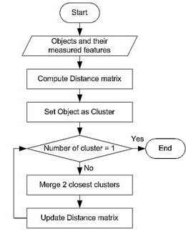
Agglomerative Algorithm
The Agglomerative algorithm is carried out in three steps:
Convert all object features into a distance matrix
Set each object as a cluster (thus if we have N objects, we will have N clusters at the beginning)
Repeat until number of cluster is one (or known # of clusters)
  Merge two closest clusters
  Update “distance matrix”
COMP24111 Machine Learning

Slide 7
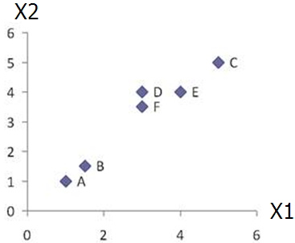
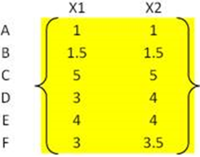
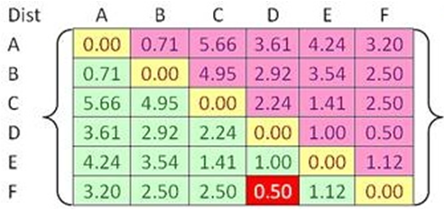


Example
Problem: clustering analysis with agglomerative algorithm
data matrix
Euclidean distance
distance matrix
COMP24111 Machine Learning

Slide 8
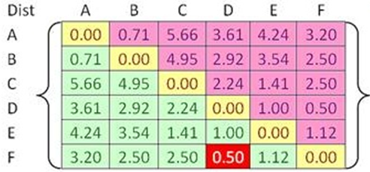
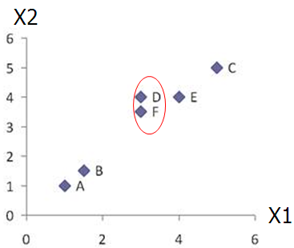
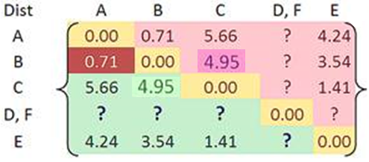

Example
Merge two closest clusters (iteration 1)
COMP24111 Machine Learning

Slide 9
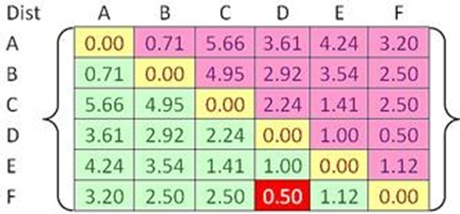

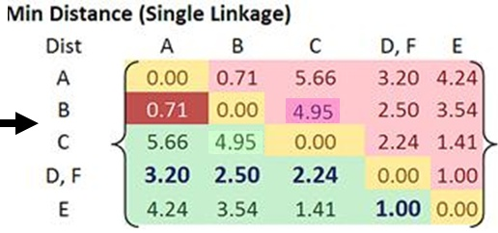
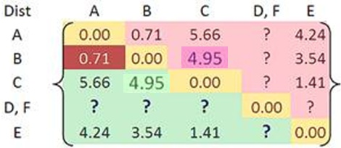
Example
Update distance matrix (iteration 1)
COMP24111 Machine Learning

Slide 10
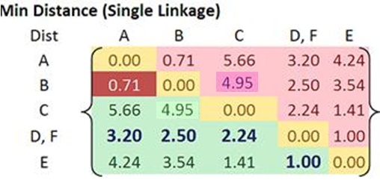
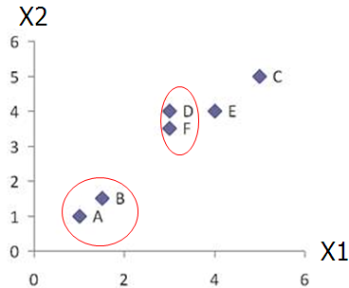
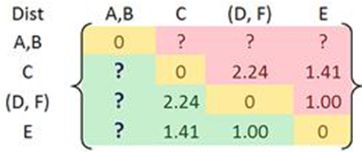
Example
Merge two closest clusters (iteration 2)
COMP24111 Machine Learning

Slide 11
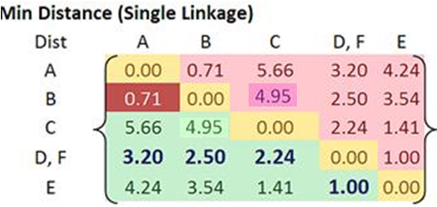
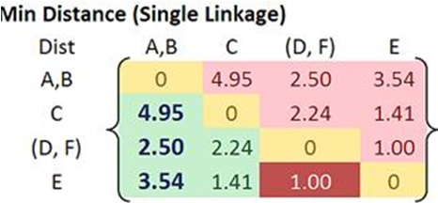

Example
Update distance matrix (iteration 2)
COMP24111 Machine Learning

Slide 12
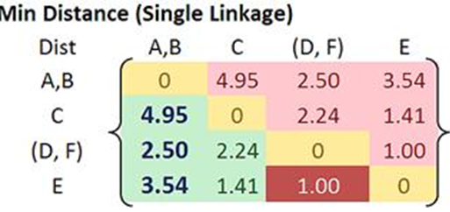
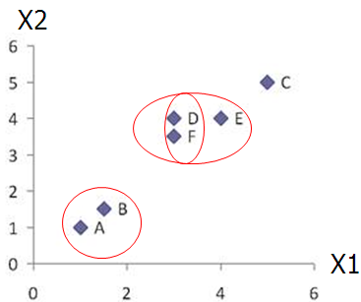
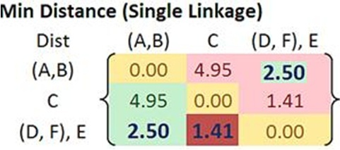

Example
Merge two closest clusters/update distance matrix (iteration 3)
COMP24111 Machine Learning

Slide 13
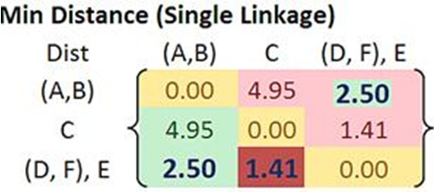
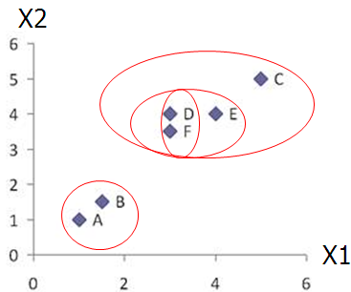
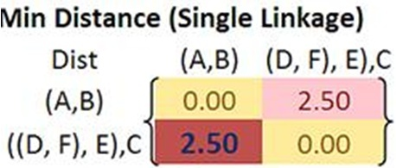

Example
Merge two closest clusters/update distance matrix (iteration 4)
COMP24111 Machine Learning

Slide 14
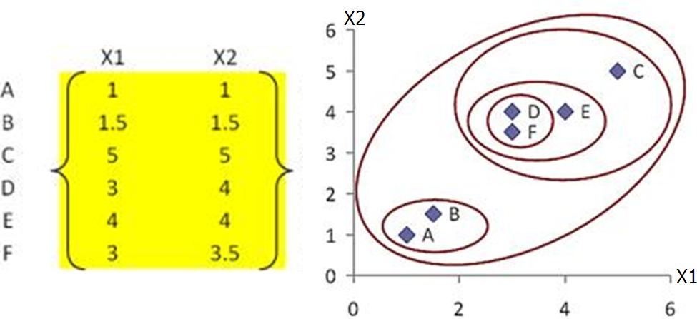
Example
Final result (meeting termination condition)
COMP24111 Machine Learning

Slide 15
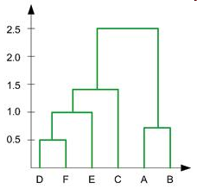
Example
Dendrogram tree representation
In the beginning we have 6
clusters: A, B, C, D, E and F
We merge clusters D and F into
cluster (D, F) at distance 0.50
We merge cluster A and cluster B
into (A, B) at distance 0.71
We merge clusters E and (D, F)
into ((D, F), E) at distance 1.00
We merge clusters ((D, F), E) and C
into (((D, F), E), C) at distance 1.41
We merge clusters (((D, F), E), C)
and (A, B) into ((((D, F), E), C), (A, B))
at distance 2.50
The last cluster contain all the objects,
thus conclude the computation
6
lifetime
5
4
3
2
object
COMP24111 Machine Learning
Notes:
For a dendrogram tree, its horizontal axis indexes all objects in a given data set, while its vertical axis expresses the lifetime of all possible cluster formation.
The lifetime of a cluster (individual cluster) in the dendrogram is defined as a distance interval from the moment that the cluster is created to the moment that it disappears by merging with other clusters.

Slide 16
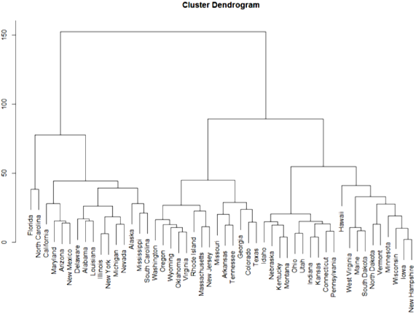
Example
Dendrogram tree representation: “clustering” USA states
COMP24111 Machine Learning
Notes:
1) The y-axis is a measure of closeness of either individual data points or clusters.
2) Because of cluster distance, California and Arizona are equally distant from Florida because CA and AZ are in a cluster before either joins FL
3) Hawaii does join rather late; at about 50. This means that the cluster it joins is closer together before HI joins. But not much closer. Note that the cluster it joins (the one all the way on the right) only forms at about 45. The fact that HI joins a cluster later than any other state simply means that (using an averaging cluster distance metric you selected) HI is not that close to any particular state.

Slide 17
Exercise
  Given a data set of five objects characterised by a single continuous feature:
  Apply the agglomerative algorithm with single-link, complete-link and averaging cluster distance measures to produce three dendrogram trees, respectively.
 | a | b | C | d | e
Feature | 1 | 2 | 4 | 5 | 6
 | a | b | c | d | e
a | 0 | 1 | 3 | 4 | 5
b | 1 | 0 | 2 | 3 | 4
c | 3 | 2 | 0 | 1 | 2
d | 4 | 3 | 1 | 0 | 1
e | 5 | 4 | 2 | 1 | 0
COMP24111 Machine Learning

